Slide 1
Machine Learning Model Deployment
Introduction to ML Pipeline

Slide 2
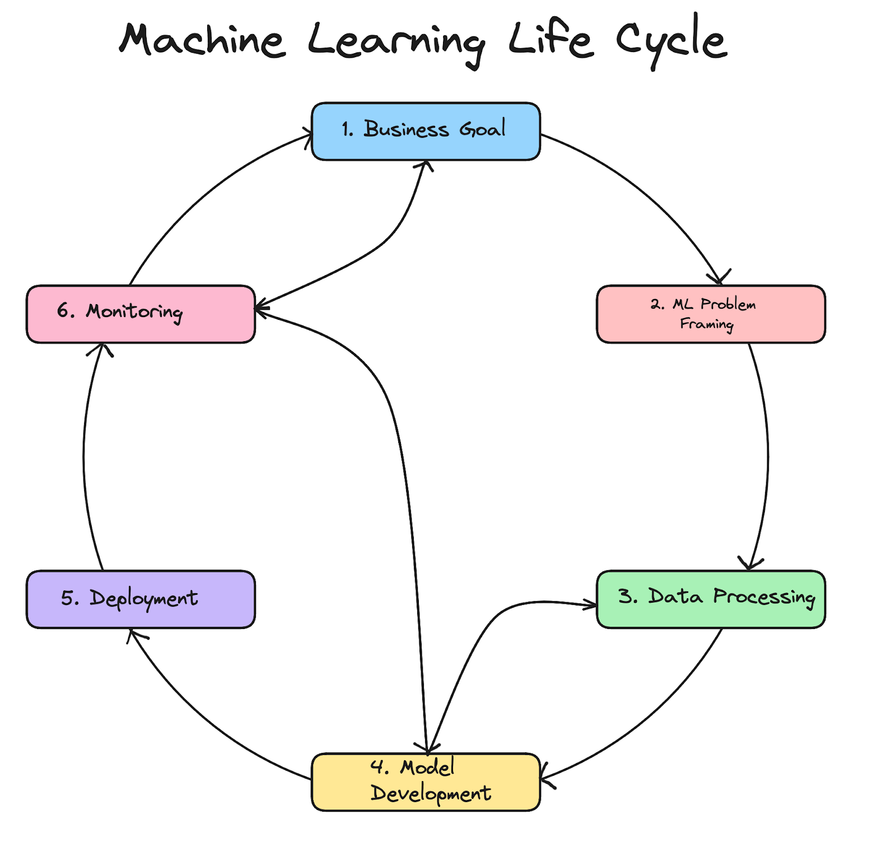
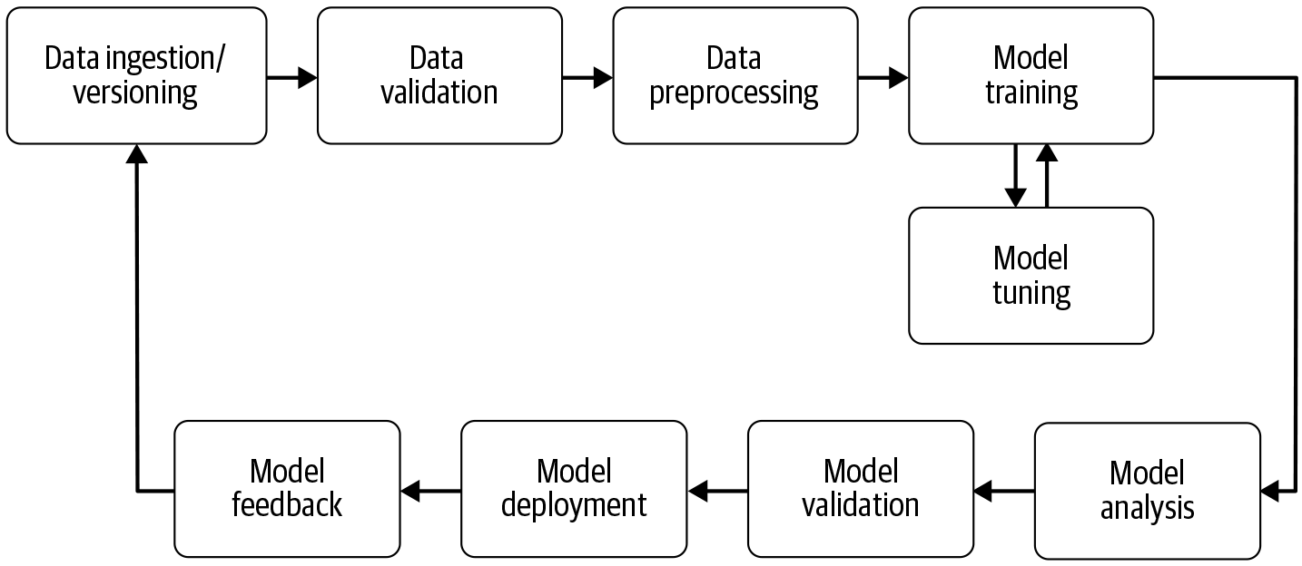
What is Machine Learning Pipeline?
Notes:
Model Deployment: Considerations, Benefits & Best Practices (markovml.com)

Slide 3
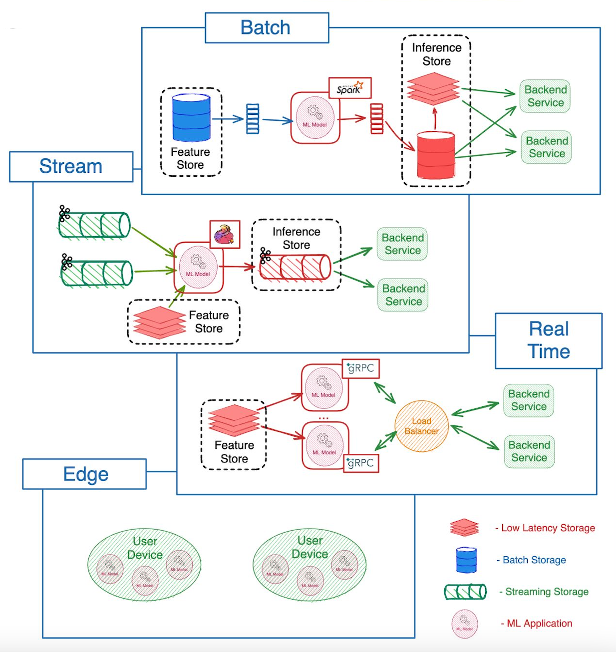
Type of ML Deployment
Batch: In batch deployment, ML models process large volumes of data at scheduled intervals, ideal for tasks like end-of-day reporting or monthly analytics.
Stream: Stream deployment enables ML models to process and analyze data in real-time as it flows in, suitable for applications like fraud detection or live social media analysis.
Realtime: Realtime deployment allows ML models to provide instant predictions or decisions in response to incoming data, essential for use cases like recommendation systems or autonomous driving.
Edge: Edge deployment involves running ML models on local devices close to the data source, reducing latency and bandwidth usage, which is crucial for IoT applications and smart devices.

Slide 4
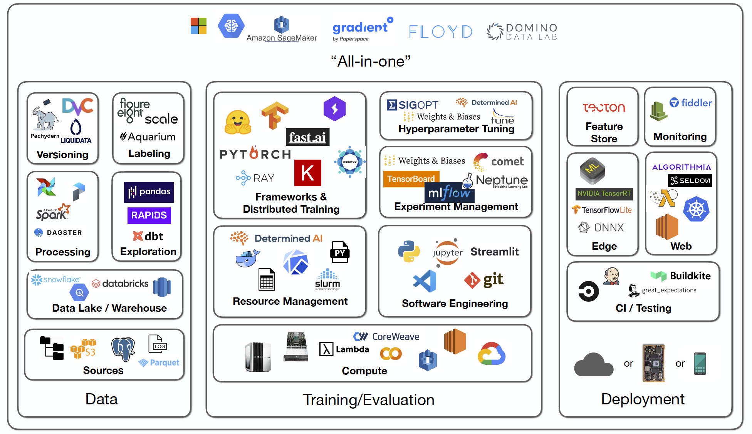
Infrastructure and Integration
Hardware and Software: Setting up the right environment for model deployment.
Integration: Seamlessly integrating the model with existing systems and applications.

Slide 5
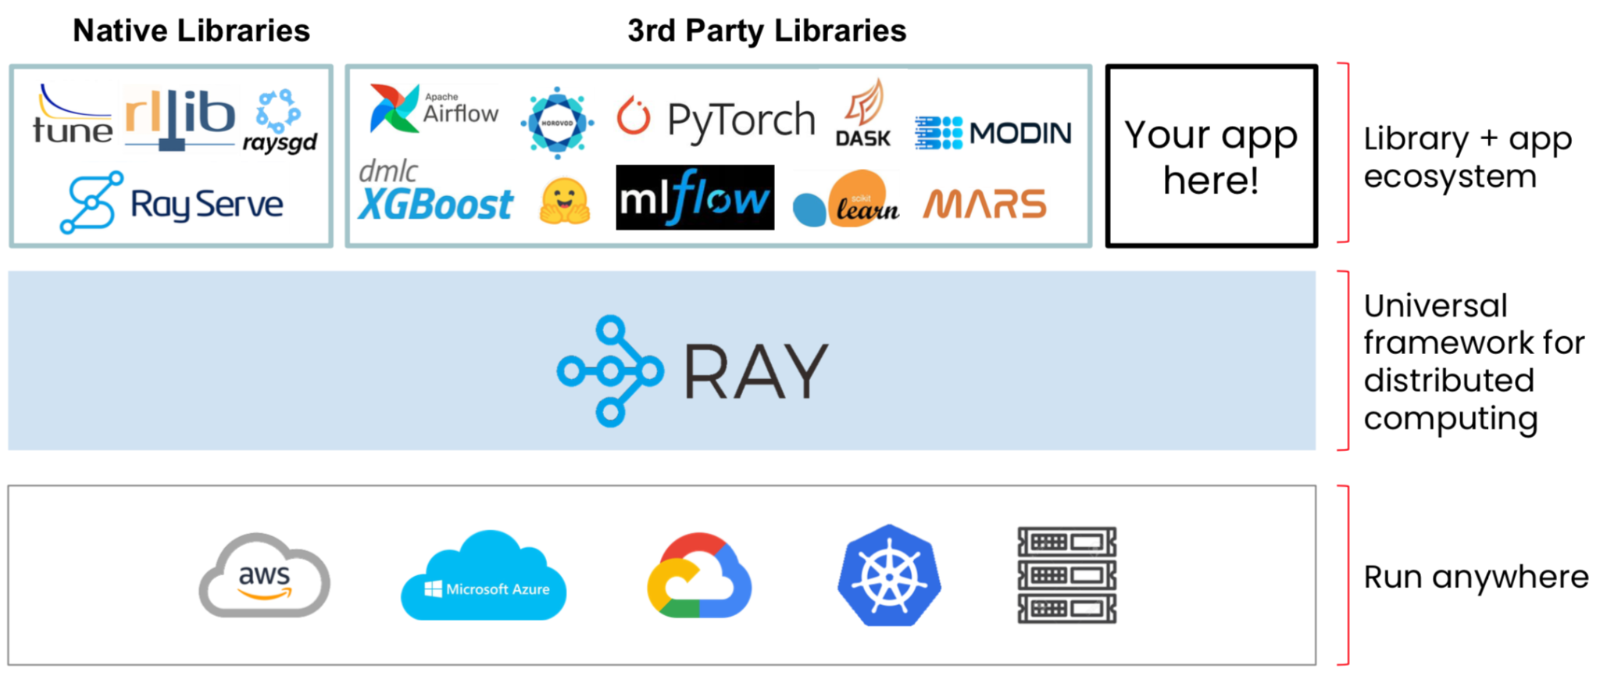
Benefits of Deploying ML Models
Focus on new models, not maintaining existing models || Prevention of bugs || Creation of records for debugging and reproducing results || Standardization || Allows models to handle real-time data and large user bases.

Slide 6
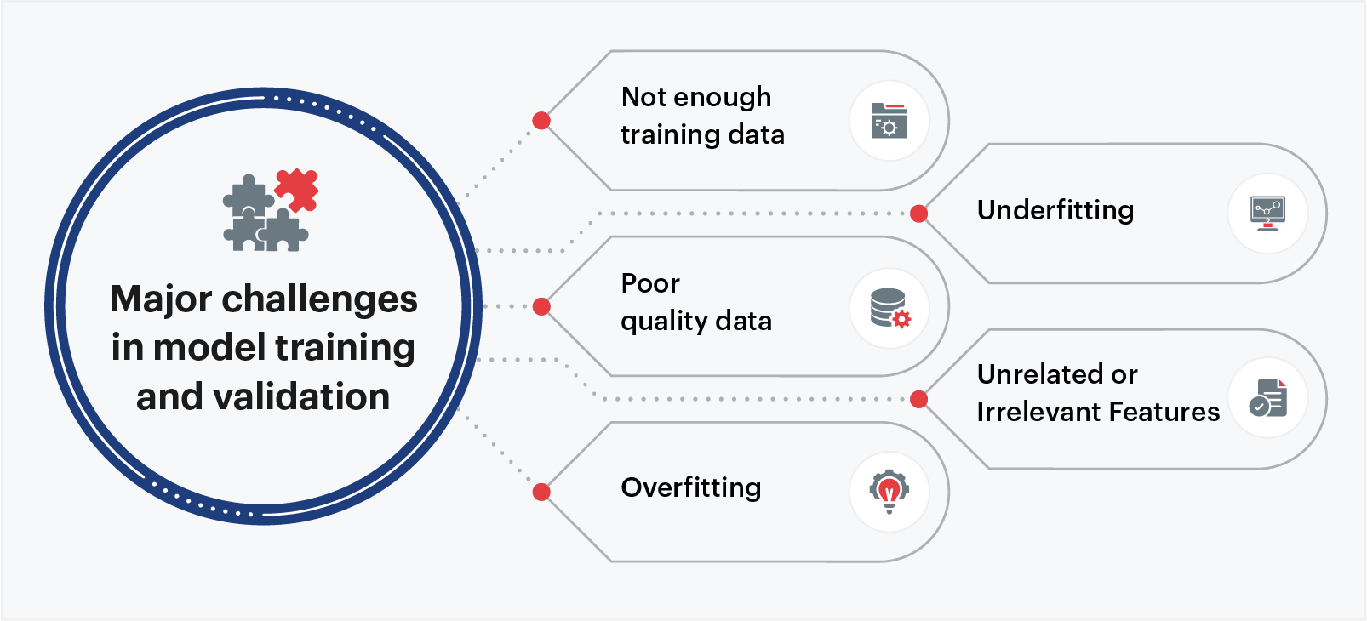
Challenges in ML Deployment
Data Management: Making sure the model gets the right kind of data.
Model Scalability and Performance: Ensuring that their model can effectively scale as it keeps adding more complex information.
Integration with Existing Systems: Fitting the model into current computers and software.
Monitoring and Maintenance: Watching and fixing the model over time.
Security and Privacy: Protecting data and keeping it private.
Resource Management: Using computer resources like memory and power wisely.
Versioning and Model Management: Keeping track of different versions of the model.
Regulatory Compliance: Making sure the model follows the laws, rules, and regulations.
User Acceptance and Trust: Getting people to trust and accept the model.
Explainability and Transparency: Being able to explain how the model works.
Cost Management: Managing how much it costs to use the model.
As per research, only 13% of ML models ever make it to production. This is a huge gap, considering the possibilities that AI model deployment can bring to the organization.

Slide 7
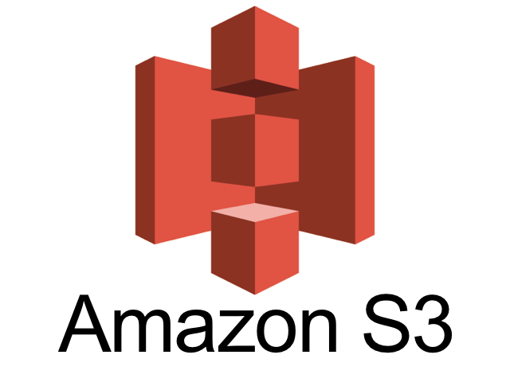
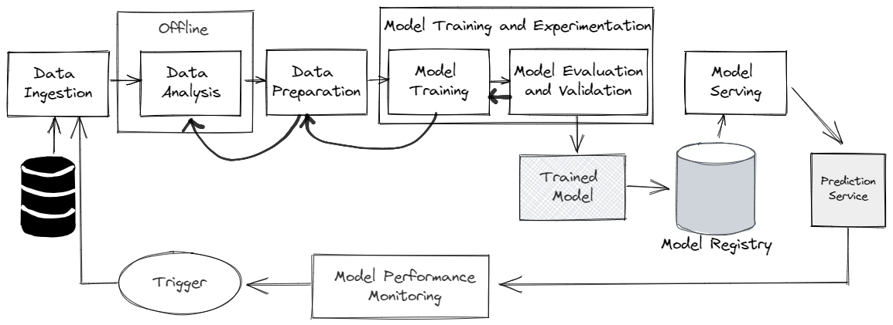


Data and Model Management
Data Pipelines: Building and maintaining data pipelines for continuous data flow.
Model Versioning: Tracking and managing different versions of models.

Slide 8
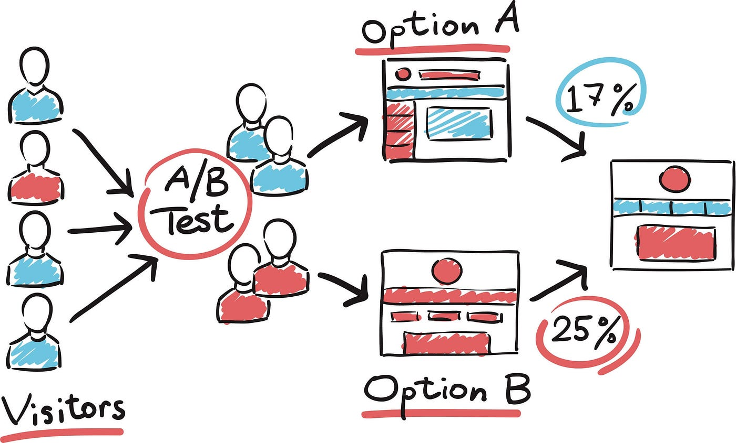
A/B Testing
Objective Comparison: A/B testing allows for an objective comparison of two model versions to determine which performs better based on specific metrics.
Real-World Application: It is widely used to optimize user experiences, such as testing different recommendation systems or ad strategies to enhance engagement or conversion rates.
Statistical Significance: The technique ensures that performance differences are statistically significant and not due to random chance by using control and treatment groups along with statistical tests.

Slide 9
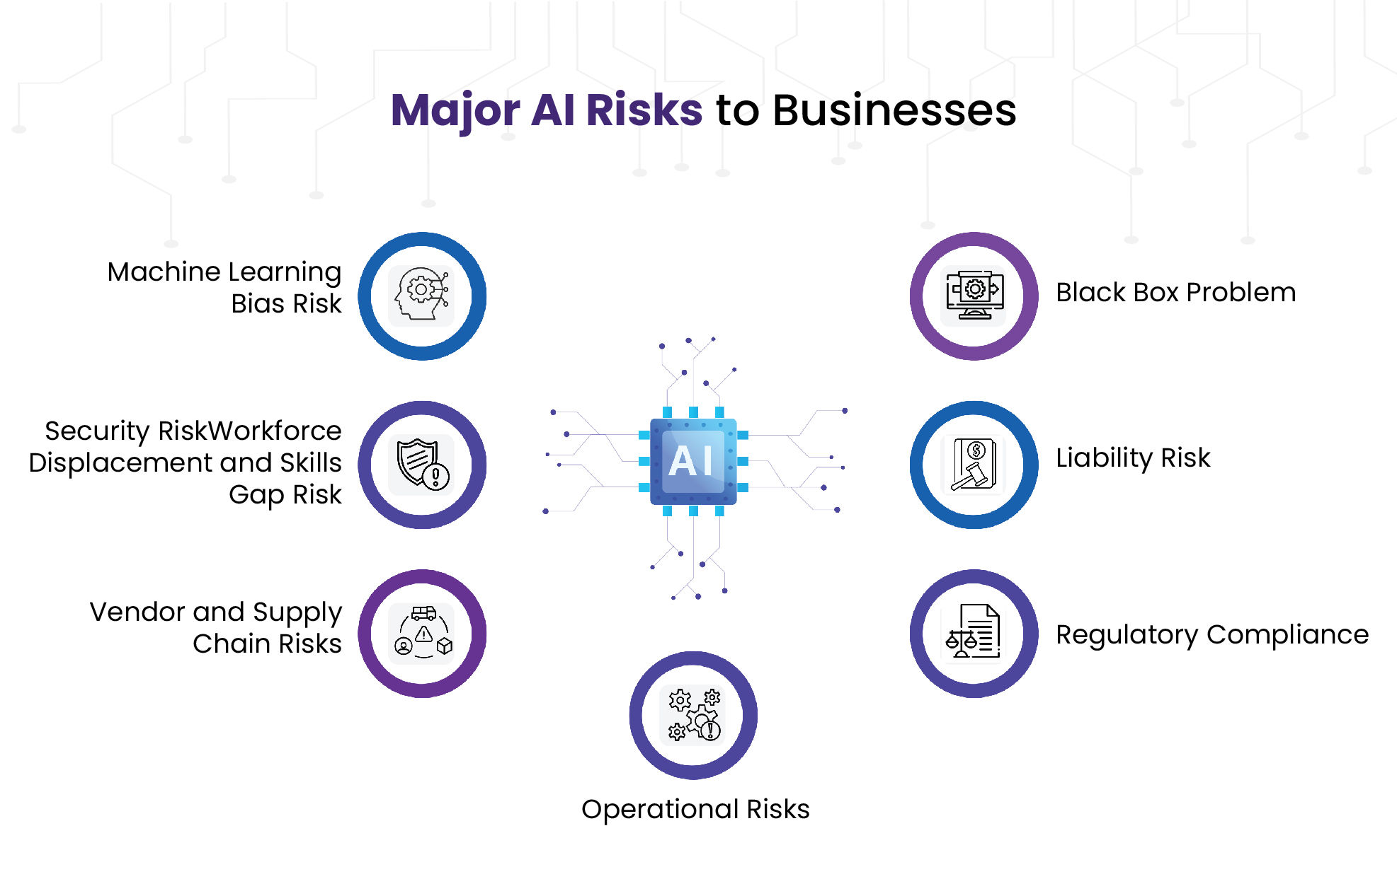
Security, Compliance and Bias
Security: Ensuring the security of machine learning models involves protecting sensitive data from unauthorized access and breaches through robust encryption, secure APIs, and access controls
Compliance: Adhering to industry regulations and standards, such as GDPR or HIPAA, is critical to ensure the legal and ethical use of data in machine learning deployments. This involves data anonymization, user consent, and regular compliance audits.
Bias Detection: Identifying and mitigating bias in ML models is crucial to prevent unfair and discriminatory outcomes. This involves using diverse training datasets, applying fairness-aware algorithms, and conducting bias impact assessments
Continuous Monitoring: Regular monitoring and updating of deployed models are essential to maintain security, compliance, and fairness. This involves real-time performance tracking, automated alerts for anomalies, and periodic model retraining.

